Slide 1
Assalamu Alikum Warahmatullah

Slide 2
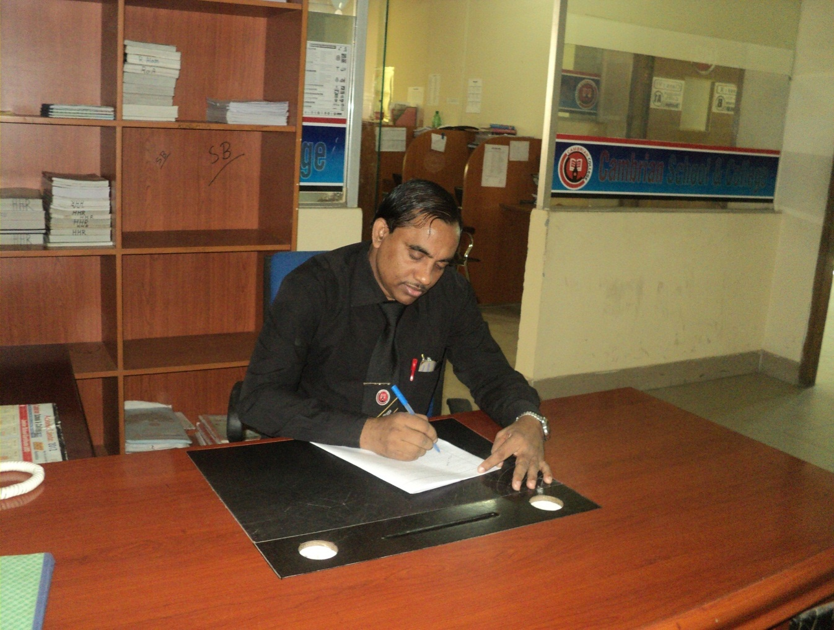
Md Hasan Hafizur Rahman
Senior Lecturer
Department of English
Cambrian School & College,Dhaka,
Class-Eight
English 1st Paper

Slide 3
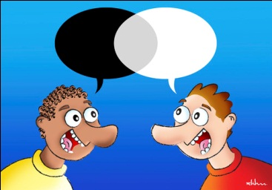
Dialogue

Slide 4
Our Today’s Lesson is-
A dialogue on
“How to improve English”

Slide 5
Learning outcomes
After we have studied this lesson we will be able to-
exchange greetings
ask and answer questions
achieve inspiration
write a dialogue.

Slide 6
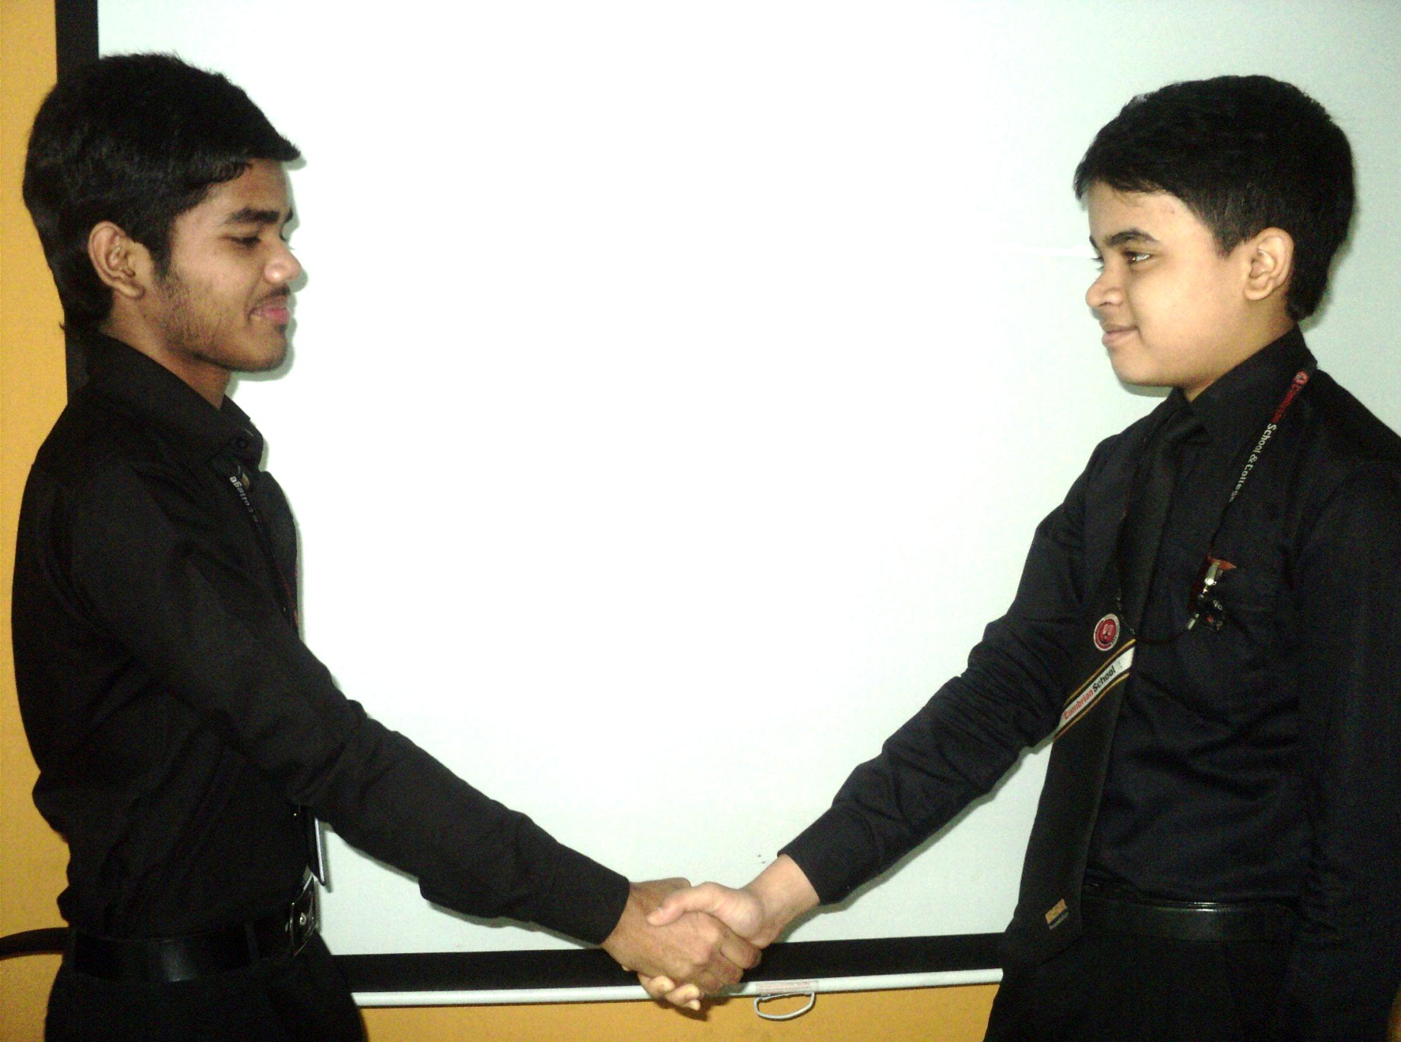
Peace be upon you my friend.
Also you. How do you do?

Slide 7
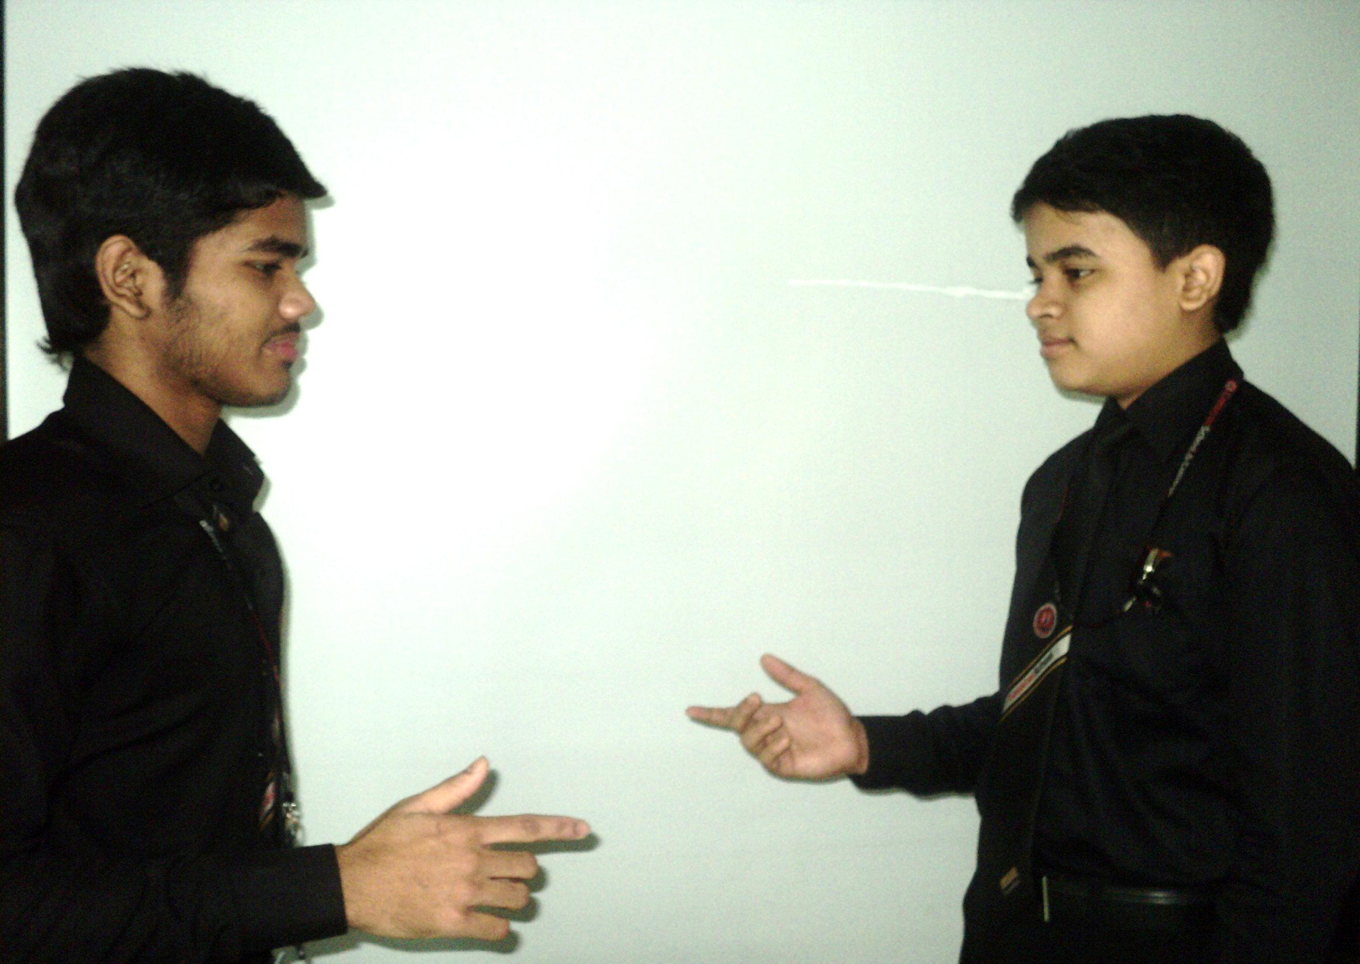
Alhamdulillah. What about you?
I am well physically but not mentally.

Slide 8
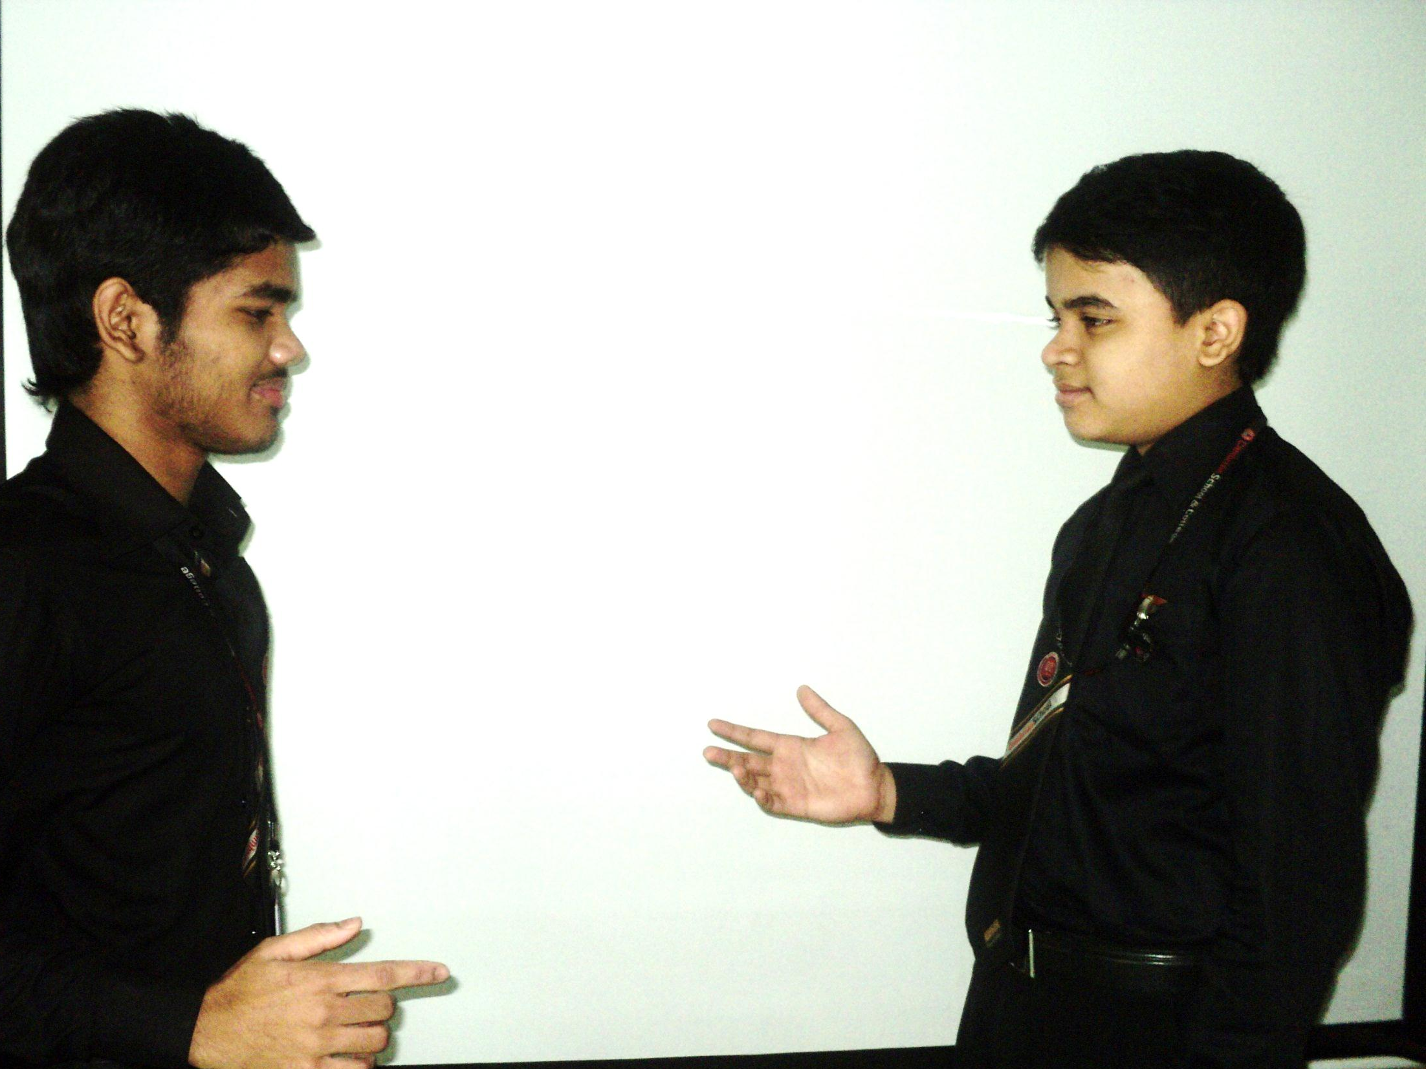
But why?
I have not done well in English in the last exam

Slide 9
What is your problem?
Actually I am not interested in English.

Slide 10
O I see.
Can you tell me how can I improve English?

Slide 11
Why not?
Please!

Slide 12
Don’t be disheartened my friend.
Ok, what can I do first?

Slide 13
You have to be prepared mentally.
What do you mean?

Slide 14
I mean you have to be determined to improve your English.
Is it enough?

Slide 15
Oh, ‘No’
Please explain.

Slide 16
You have to develop your basic skill on English.
But how?

Slide 17
You have to learn word, number, gender, sentence, tense, sentence patterns and others.
Has there any fixed skill to develop English?

Slide 18
Yes, there are four skills to improve your English
What are they?

Slide 19
They are listening, reading, writing and speaking.
Ok.

Slide 20
Have you any question more?
If there is anything more, please tell me.

Slide 21
Remember, “Practice makes a man perfect.” You have to continue practice it.
Ok. I will try my level best to follow your instructions.

Slide 22
I wish you best of luck.
Allah Hafez.

Slide 23
Pair Work
Every single pair is suggested
to write a dialogue on,
“ How to improve English

Slide 24
Evaluation
Answer the following questions-
Why is it necessary to learn grammar?
What is the importance of learning vocabulary?
How many skills are there in English Language?
Why is practice necessary to develop English?

Slide 25
Homework
Write a dialogue with your friend about
“How to improve English”

Slide 26
Verse Universal
“Speak English,
be smart”

Slide 27
Alallahu Khairan Hafezan wahua Arhamur Rahimin

